Slide 1
LinkedIn Profile for the Job Seeker
Notes:
Good Morning/Afternoon, I’m _________and my class today is the LinkedIn for the Job Seeker. This class is to teach everyone the basics of LinkedIn profiles and how to build a successful profile for employment. Please follow the LinkedIn class handout that is located in your folder.

Slide 2
About LinkedIn
LinkedIn is FREE
Premium account cost $$ but it is free for 1 year for Veterans
Resume on Steroids
Notes:
LinkedIn is FREE! There is a Premium version for which you can pay a monthly fee. However, veterans have the opportunity to enjoy one year of free Premium by following this link: https://linkedinforgood.linkedin.com/programs/veterans/premiumform. LinkedIn is like a professional facebook and a resume on steroids rolled into one.

Slide 3
Profile Picture
Clear headshot
Shoulders and up
Neutral background
Civilian attire
Business attire or business casual
NO DoD photo…..why?
Notes:
We’ll start off with the profile picture. Should be a clear headshot from the shoulders up with a neutral background.
Business attire or business casual is a must! An idea is to dress how you would look like at a job interview.
DO NOT use your DoD Photo or pictures in uniform.
We’re looking for private sector work so we want to put our military face away and put our business professional face forward!

Slide 4
Cover Photo
Make it work related
Carpenter - wood projects
VA - Service emblems
Research Technician - lab beakers
Mechanic - tools or favorite car
Notes:
Next, is the cover photo. Make it something relating to the type of work you do or have done. For example: a wood worker might have a picture of his latest project, someone in veteran’s affairs might have service branch emblems, or a scientist who has beakers containing colored fluid or lab mice.

Slide 5
Headline
Have your headline state “Actively looking / pursuing”
Notes:
The headline is like a title to your profile giving a snip of what you are pursuing or looking for in an employment. Be sure that your headline states that you are looking for a job such as “actively pursuing laboratory, quality assurance, research, and pharmaceutical jobs”

Slide 6
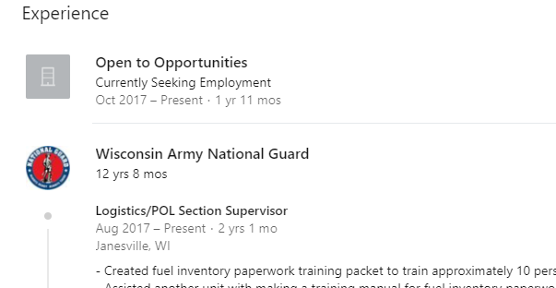
Job Status
Should state:
Currently Seeking Employment
Open to Opportunities
Notes:
Do not list your last job as your current position or people may become confused as to whether you are looking for a job or not. Instead, your current company should reflect that you are looking for a job:
“Currently seeking employment”
“Open to opportunities”
Caveat: If you are still in the National Guard, yes this is technically a current position. However, you are looking for full time employment. We want recruiters to know that!

Slide 7
“About” Section
1st paragraph:
Describe the perfect job for you
2nd paragraph:
30 Second Elevator Speech – What’s that?
Add media:
General Resume and Cover Letter
Video of 30 Second Elevator Speech
Notes:
The FIRST PARAGRAPH of your summary should describe the perfect job for you. Be sure that you use clear language and you describe your goals and the ideal position.
The SECOND PARAGRAPH is your 30-second elevator speech. The elevator speech is a brief summary of what qualities you have to offer the employer if they were to hire you.
Media: You can add media to this section. For example, you can add a general resume and cover letter. You can also add a video clip of your 30-second elevator speech.

Slide 8
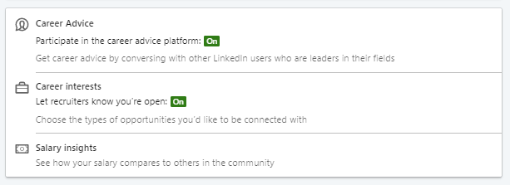
Career Interest Let the recruiters know you are open
Notes:
In order for your profile to be at the top of the search list, you need to have the Career Interests turned ON. When you turn this on then the employers know you are looking and specifics of what type of job you are looking for. The options are full-time, contract, part-time, internships, volunteering, or temporary. You can add what types of job positions you are looking for and you write a detailed note for recruiters, as well.

Slide 9
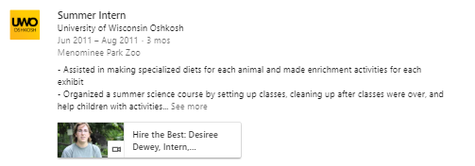
Work Experience
Do NOT limit to 1 page
More bullets = more key words
Bullet vs Paragraph
Master resume
Can add media
Notes:
The Experience section of your LinkedIn profile is your “Work Experience.”
Add ALL jobs in this section, it increases the amount of searchable keywords on your profile. This increases the keywords for employers to find you. You can add multiple positions to one job location. (i.e. Wisconsin Army National Guard)
You can also add as many bullets as you like but NO FLUFF or REPEAT of the same bullet.
Load your experience with key words that recruiters in your field are looking for example for lab jobs: Quality assurance, data analysis, laboratory technician, lab assistant.
LinkedIn is a resume on steroids and should not be limited to one page. This is where you show off your experience and illustrate who you are and what you offer. Write as many bullets as you can think of for each position block. This can also be used as your Master Resume. When you are tailoring your resume to the job you are applying for, you can copy and paste bullets from your master resume to your tailored resume. This way you don’t have to start from scratch.
There are two ways of writing about your experience: bullet format and paragraph. I suggest BULLETS, but you will see some people with paragraph format on their profile. This is ok but it’s hard to work with when you write in a paragraph form.
You can add media to this section as well. This is a good place to really show them who you are. Ideas for this space included: Web links to companies or other social media sites, letters of recommendation, resume and CV documents, cover letters, business cards, portfolio, etc.

Slide 10
Education
Add High school and Colleges
Activities, Athletics, Club
GPA
Notes:
Make sure you include each college you attended and your high school. This helps LinkedIn identify people to suggest that you connect with. Include all of your activities, honors, GPA and achievements.

Slide 11
Skills & Endorsements
Can add up to 50
What’s an endorsement?
Notes:
This section can also help increase the amount of keywords employers are looking for.
You are allowed to have 50 skills. You should fill them up with skills recruiters and employers in your field would be looking for. Endorsements are credibility to the skills you added to your profile. Your connections can endorse your skills to show employers the credibility behind the skills you have picked.

Slide 12
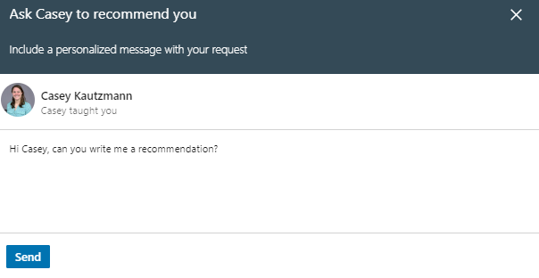
Recommendations
At least 2-4 per job
Ask for a recommendation with personalized note
You can give recommendations too!
Notes:
You want to shoot for 2 or 3 recommendations per job. The best way to accomplish this is simply by asking your coworkers and supervisors to write you one.
You may also do this by clicking the “Ask to be recommended” button and make sure you write a personalized note. Write to the person you are asking for a recommendation to guide them what to write about. You can also review the recommendation before having it posted, you can make the posting invisible and you can ask the writer to change the recommendation posting.

Slide 13
Accomplishments
Can add:
Publications
Patents
Courses (up to 50)
Projects
Honors & Awards (i.e. Military)
Test Scores (i.e. MCAT, LSAT, GRE, GMAT, etc.)
Languages (add proficiency)
Organizations
Notes:
Add the accomplishments that apply to you. For example, if you got a good score on a professional entrance exam (GRE, GMAT, LSAT, OAT, etc.) you may add the score here. Any certifications you hold can also be included in this section. Don’t be afraid to add college courses here too, especially if you are a student or recent graduate. (Up to 50 courses)
Can also add: awards (military), languages (with proficiency), publications, patents, projects, and affiliated organizations.

Slide 14
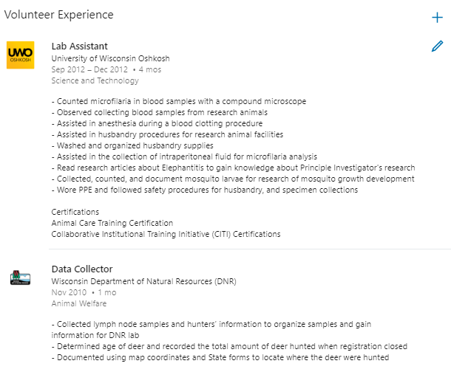
Additional Profile Sections
Volunteer
Licenses & Certifications
Notes:
There are two sections which can be added to your LinkedIn profile: Volunteer and Licenses & Certifications.
Volunteer Experience can be listed like the Work Experience to add more keywords. It will also help show employers more skills you have obtained outside of work.
Licenses & Certifications can be listed to show employers you gained certifications or licenses towards the career you are pursuing.

Slide 15
What to do next???
Check grammar and spelling - You can use Grammarly.com and it’s FREE
Make connections!
Keep profile up to date
More tips go on http://www.powerformula.net/
Notes:
Make sure that your writing is free of errors. Copy and paste your sections into a Word document before you publish it. Better yet, go to grammarly.com. This site not only identifies spelling and grammatical errors, it also finds run-on sentences, word misuse, and more.

Slide 16
Any Questions?

